Slide 1

Responsive Web Designing Using CSS3 & HTML5

Slide 2

Contents
Mobile is Future
What is Responsive Web Designs
Why do you need Responsive web designs
Adoptive vs Responsive web designs
Key benefits of Responsive web designs
How does it works
Frameworks.
Demo

Slide 3
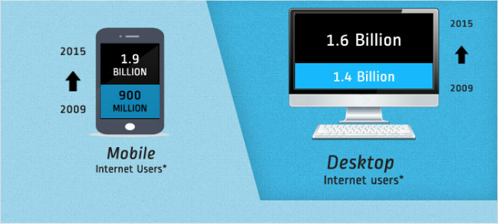

Mobile in Present

Slide 4
Why do you need Responsive web designs?
The Number of devices, platforms and browser that need to work with your website is growing exponential rate.
New devices with varying screen resolution

Slide 5
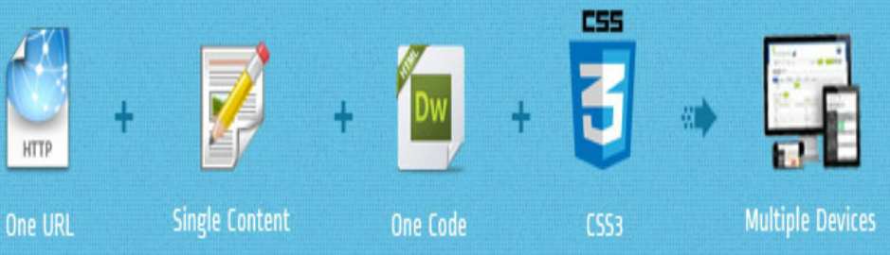
What is Responsive Web Designs
Responsive Websites respond to there environment.
Responsive Web Designing (RWD) is a process of designing a single website to be used and compatible on different portable or handy electronic devices with different Screen size , platform and orientation .

Slide 6
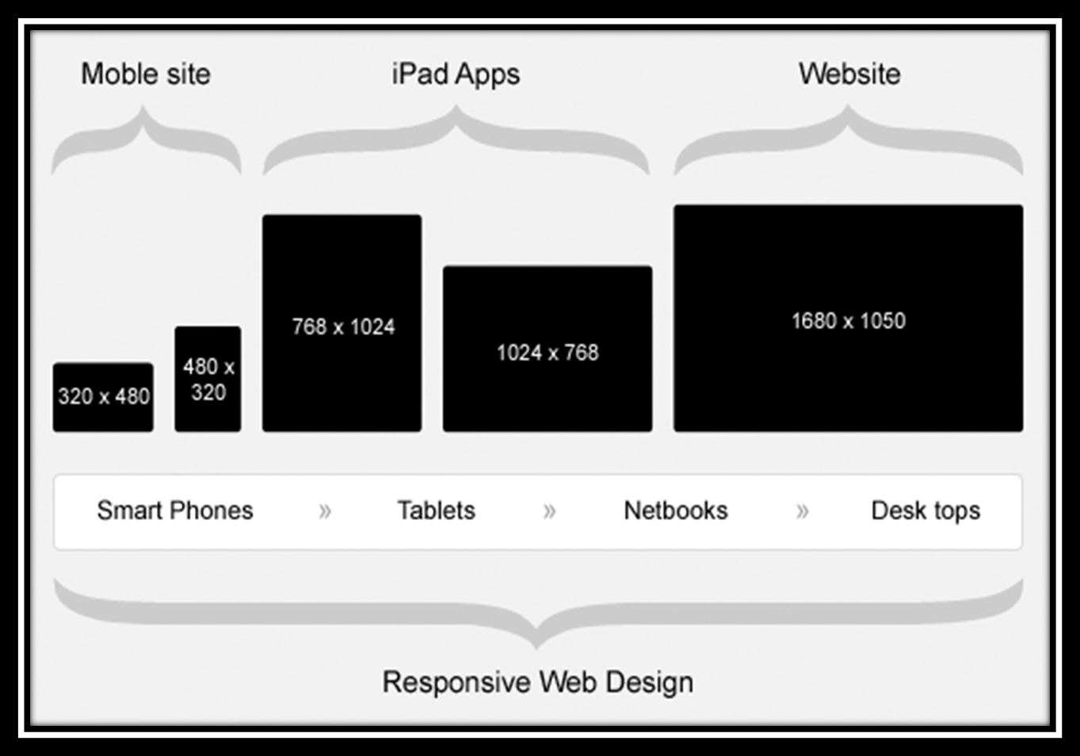
How does it work / Responsive Process

Slide 7
Adoptive Vs Responsive web designs
AWD depends on predefined screen sizing
RWD depends on flexible and fluid grids
AWD possesses a consistent and layered approach using scripting
RWD consists of a little more coding approach with fluid grids & CSS
AWD is recommended for end users with a limited budget or limited device types and screen sizes. It is also better for applications which have a lot of images which do not scale well
RWD is recommended for end users for whom budget is no question and who need a variance of mobile devices for their application to be implemented.

Slide 8

ADVANTAGES of Responsive Web Design
User Experience (UX): Website adjusts to any screen size, making it a good long-term solution to UX with the current plethora of devices (including mobile/tablet hybrids). Hiding elements which aren't crucial for mobile visitors helps to achieve their goals faster.
Analytics: One complete view for all the traffic. To get insights on the mobile visitors, create a "mobile-only" segment
Sharing/Linking: One URL to accumulate all of the shares, likes, tweets, and inbound links.
SEO: Going with the advantage above, one URL accumulates all links, PageRank, Page Authority, etc.

Slide 9
Key benefits of Responsive web designs
Save money
Save Time
Better performance
Improved SEO
Wider browser support

Slide 10
How does it works
A flexible grid
A flexible grid-based layout is one of the cornerstones of responsive design.
Stop using pixel-based layouts and start using percentages or the em for sizing
Flexible images and media
Adapt your images or other media to load differently depending on the device, either by scaling or by using the CSS overflow property
CSS3 media queries
You can use media queries to scope styles to specific capabilities, applying different styles based on the capabilities that match your query

Slide 11
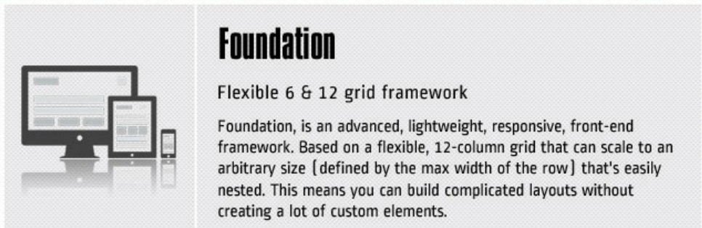
Frameworks

Slide 12


THANK YOU
This Photo by Unknown Author is licensed under CC BY-SA

